Slide 1
Genpact Data Science Prodegree Project Using Python
Credit Industry

Slide 2
Definition
Machine learning is an application of artificial intelligence (AI) that provides systems the ability to automatically learn and improve from experience without being explicitly programmed.
Example: Social Media, Face Recognition, Chatbots etc

Slide 3
History
1950 — Alan Turing creates the “Turing Test” to determine if a computer has real intelligence. To pass the test, a computer must be able to fool a human into believing it is also human.
1952 — Arthur Samuel wrote the first computer learning program. The program was the game of checkers, and the IBM computer improved at the game the more it played, studying which moves made up winning strategies and incorporating those moves into its program.
1957 — Frank Rosenblatt designed the first neural network for computers (the perceptron), which simulate the thought processes of the human brain.
1990s — Work on machine learning shifts from a knowledge-driven approach to a data-driven approach. Scientists begin creating programs for computers to analyze large amounts of data and draw conclusions — or “learn” — from the results.
1997 — IBM’s Deep Blue beats the world champion at chess.

Slide 4
Evolution
2010 — The Microsoft Kinect can track 20 human features at a rate of 30 times per second, allowing people to interact with the computer via movements and gestures.
2011 — Google Brain is developed, and its deep neural network can learn to discover and categorize objects much the way a cat does.
2014 – Facebook develops DeepFace, a software algorithm that is able to recognize or verify individuals on photos to the same level as humans can.

Slide 5
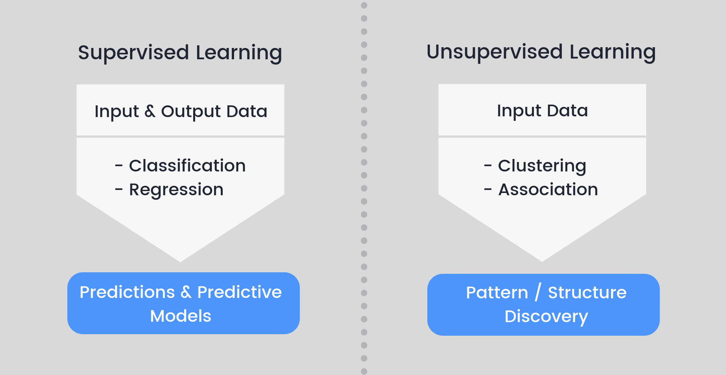
Types of Machine Learning

Slide 6
Regression
Regression models are used to predict a continuous value. Predicting prices of a house given the features of house like size, price etc is one of the common examples of Regression. It is a supervised technique.
Consider predicting the salary of an employee based on his/her age. We can easily identify that there seems to be a correlation between employee’s age and salary (more the age more is the salary). The hypothesis of linear regression is Y = a + Bx.
Y represents salary, X is employee’s age and a and b are the coefficients of equation. So in order to predict Y (salary) given X (age), we need to know the values of a and b (the model’s coefficients).

Slide 7
Classification
Classification is technique to categorize our data into a desired and distinct number of classes where we can assign label to each class.
Binary classifiers: Classification with only 2 distinct classes or with 2 possible outcomes
example: Male and Female, positive and negative sentiment
Multi-Class classifiers: Classification with more than two distinct classes.
example: classification of types of soil, classification of types of crops

Slide 8
Problem Statement
In this project you will have to put yourself in the shoes of a loan issuer and manage credit risk by using the past data and deciding whom to give the loan to in the future. The text files contain complete loan data for all loans issued by XYZ Corp. through 2007-2015. The data contains the indicator of default, payment information, credit history, etc.
The data should be divided into train (June 2007 - May 2015) and out-of-time test (June 2015 - Dec 2015) data. You will have use the training data to build models/analytical solution and finally apply it to test data to measure the performance and robustness of the models.

Slide 9
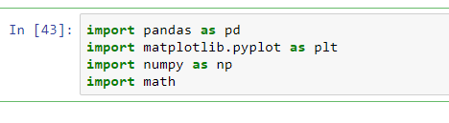
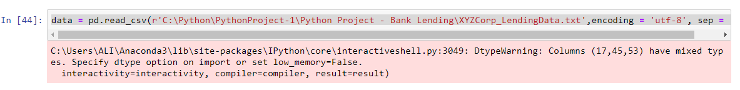
Import Packages and Data

Slide 10
Create a copy
#create a copy of the data frame to revert back to changes
df=pd.DataFrame.copy(data)

Slide 11
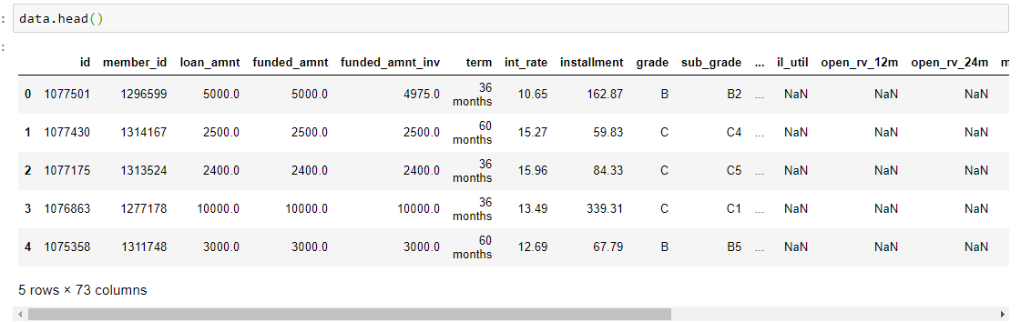

Data Definition

Slide 12
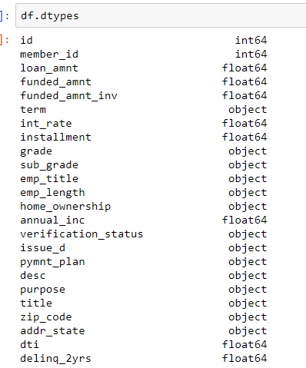
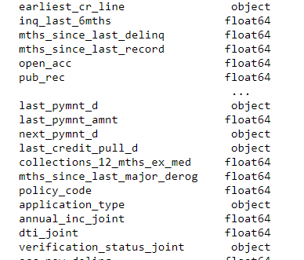
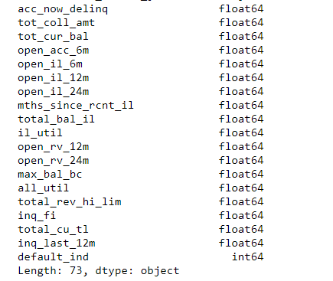
Data Definition

Slide 13
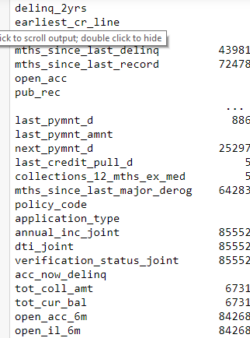
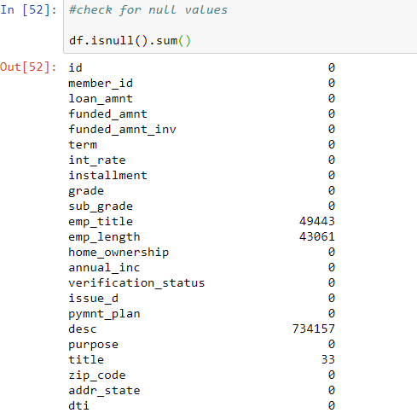
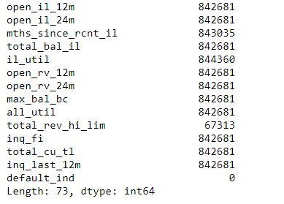
Data Cleaning

Slide 14
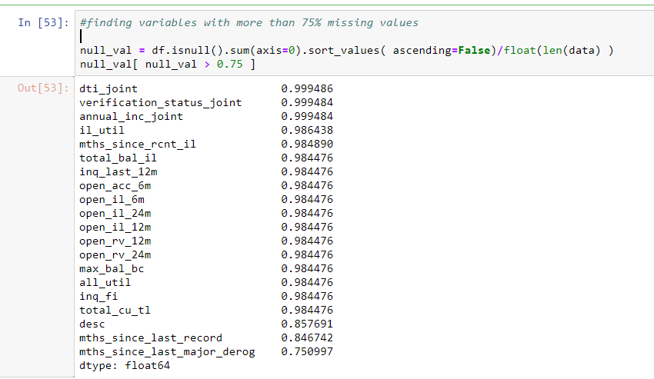
Finding variables with more than 75% missing values

Slide 15

Some columns have missing values more than 75% when compared to the original values.
So we will take 0.75 as threshold and eliminate all the columns with more than 75% missing values
BEFORE AFTER

Slide 16
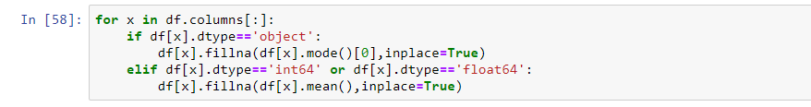
Generic Code to impute the missing values
We use Mode in case of 'Object Variables' and Mean in case of 'Numeric Variable' to impute missing values

Slide 17
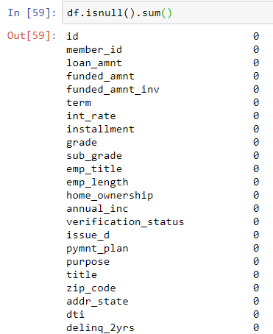
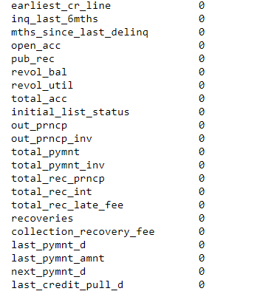
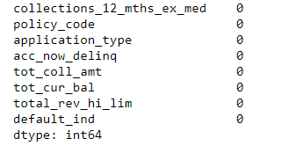

Slide 18
Feature Selection
Removing the logically unimportant variables
1) policy_code as all the values are '1'
2) pymnt_plan as all the values are 'n'
3) 'id' and 'member_id' : there should be a unique id but in this case there are 2 id's creating confusion
4) 'initial_list_status' as it not an important factor
5) acc_now_delinq as it has similar value '0' for more than 99%
6) emp_title and title
7) zip_code doest not matter for loan qualification
8) sub_grade as there exixts a similar variable called 'grade' already
9) pub_rec as public record is not logically important
10) addr_state as address is not important for loan
11) inq_last_6mths and open_acc are not important factors

Slide 19
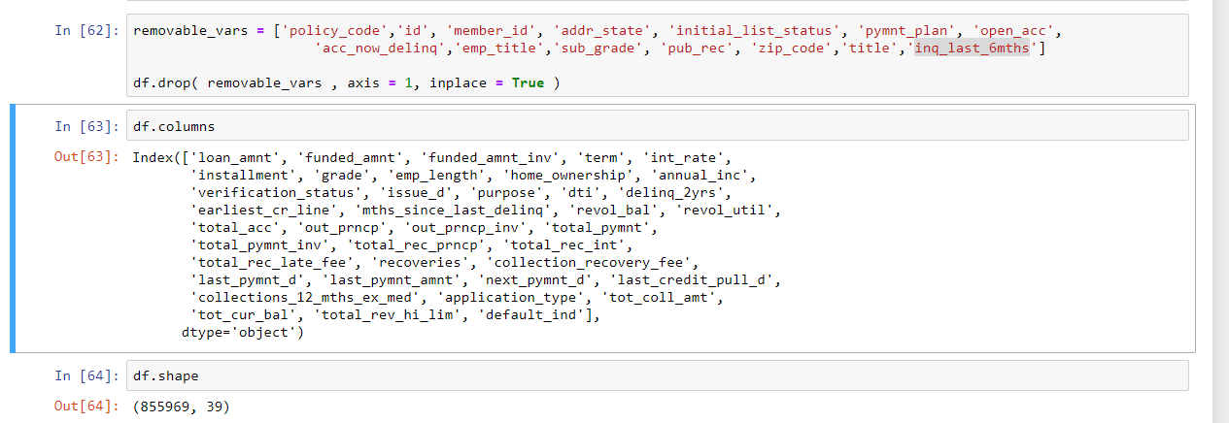

Slide 20
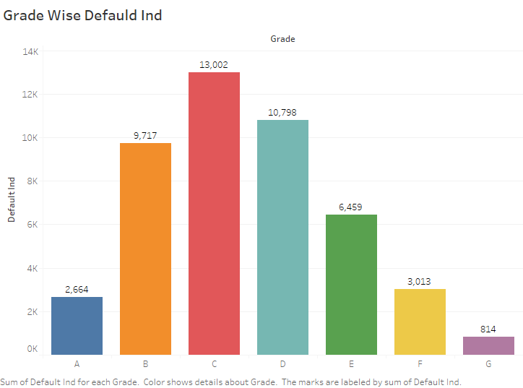
Data Visualization

Slide 21
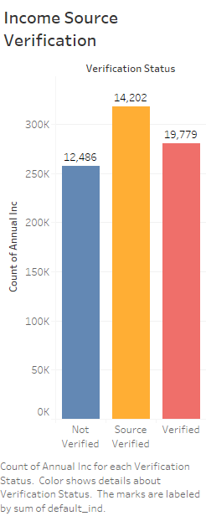

Slide 22
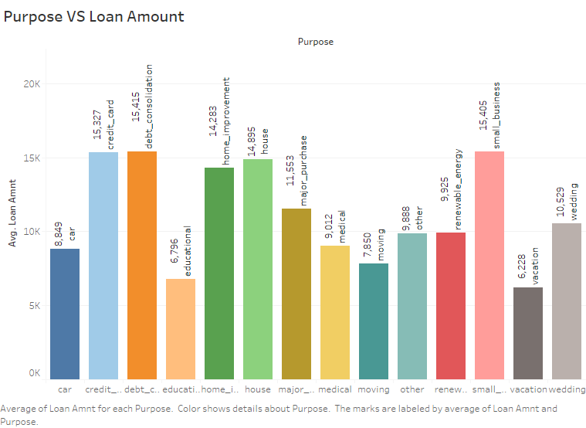

Slide 23
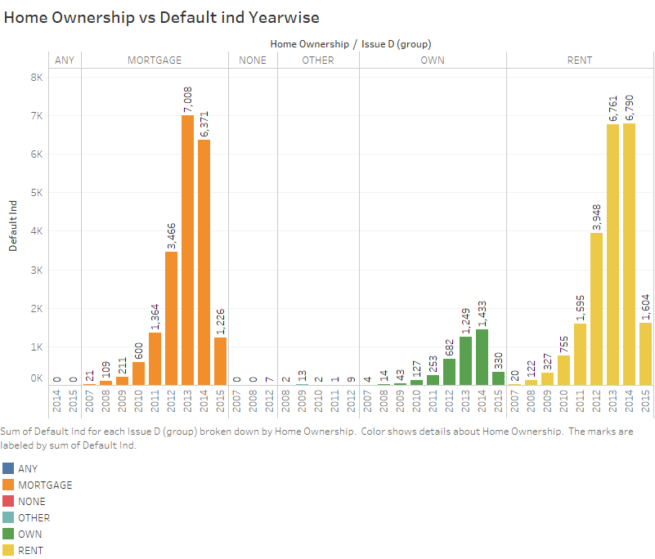
Data Visualization

Slide 24
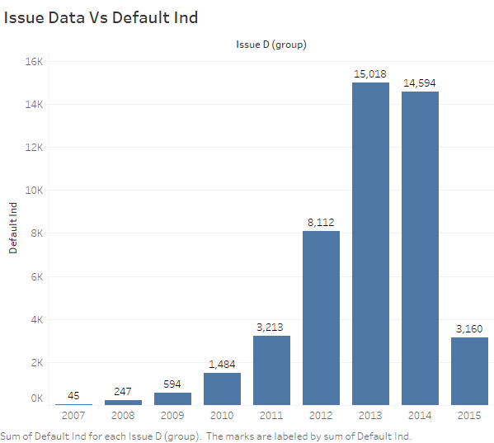

Slide 25
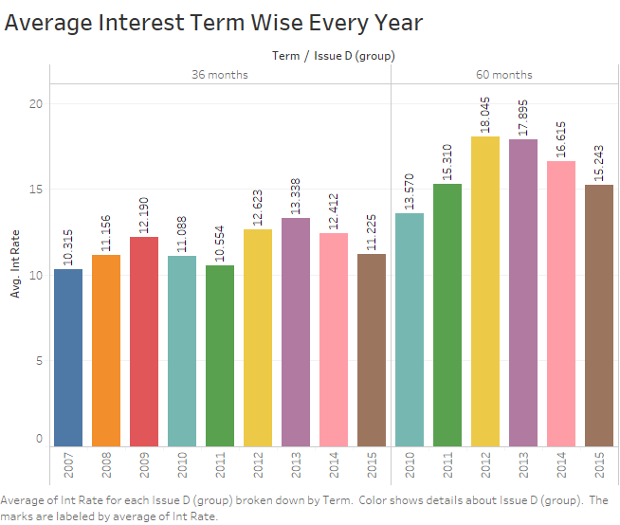

Slide 26
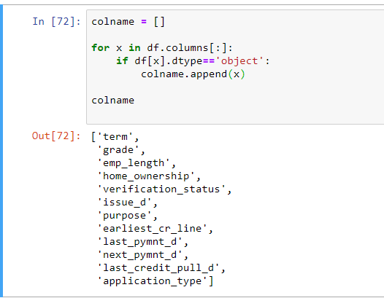
Conversion
Finding the object variables in the dataframe using 'for' loop

Slide 27
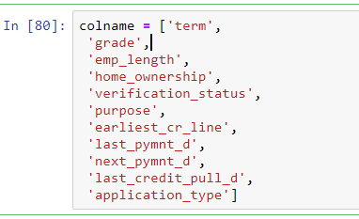
After getting a list of all object variables we notice that the variable 'issuue_d' is also present in the list. As we need 'issue_d' in the next few steps to split data we will exclude it from the list to further convertit into a datetime variable

Slide 28
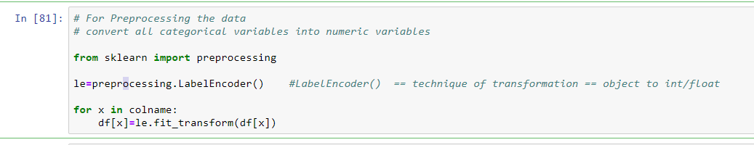
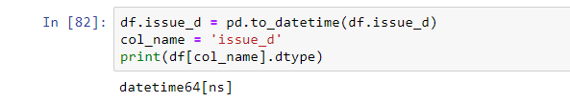
Convert all categorical variables into numeric variables
Convering 'issue_d' into datetime for splitting the data

Slide 29
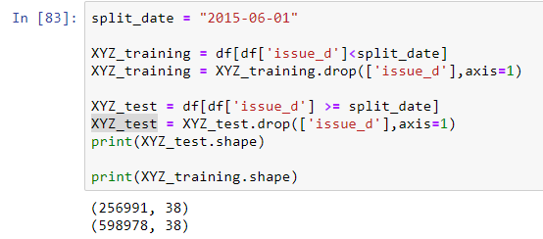
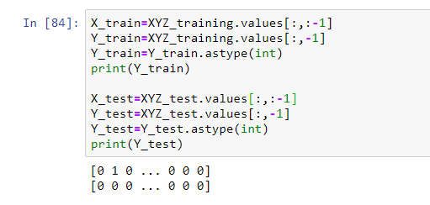
Split the data into train and test according to the condition given in the problem statement

Slide 30
Standard Scaling
Scaling X_train and X_test for model building
Scaling is not compulsory but can be used to get better accuracy
Scaling can be done only on X
Standardization is used mostly for better accuracy
Fitting is only done on training data

Slide 31
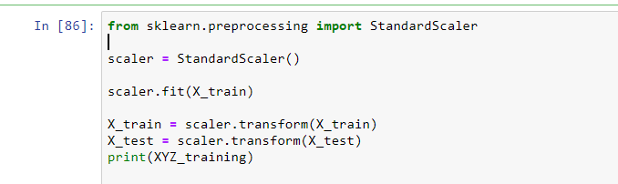

Slide 32
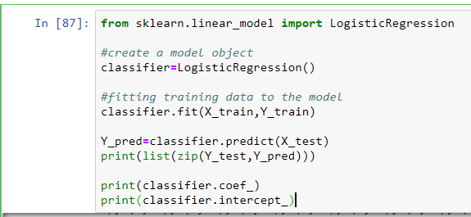
Logistic Regression

Slide 33
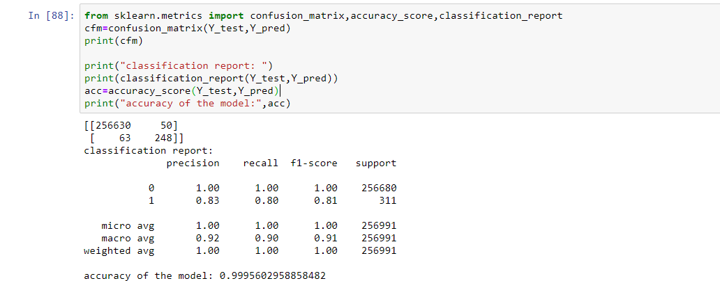

Slide 34
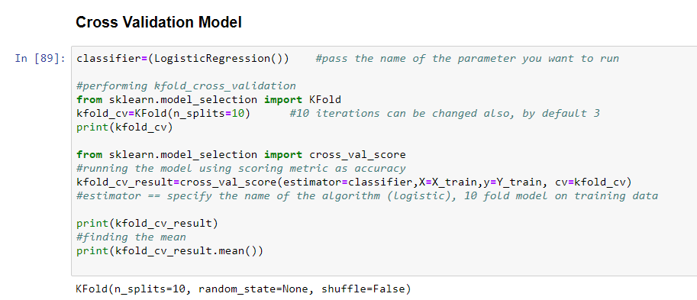
Cross Validation For Logistic

Slide 35
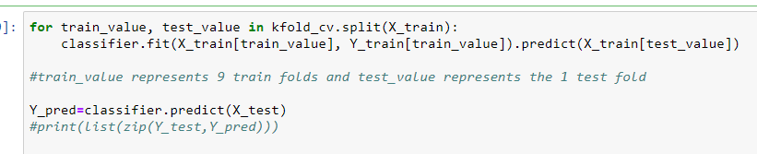

Slide 36
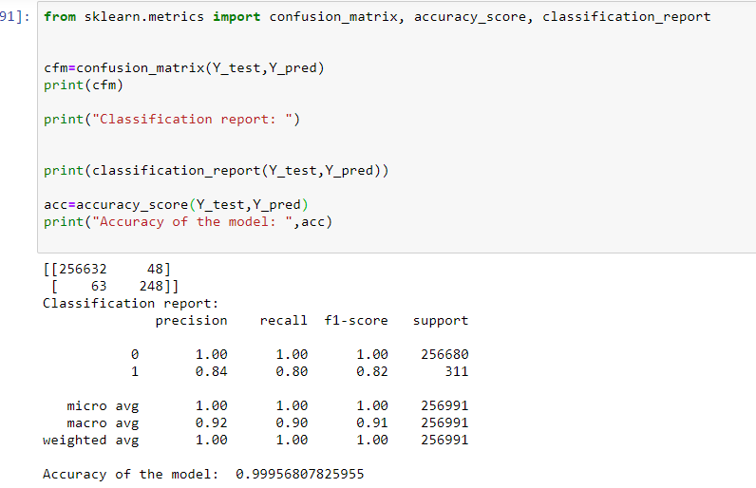

Slide 37
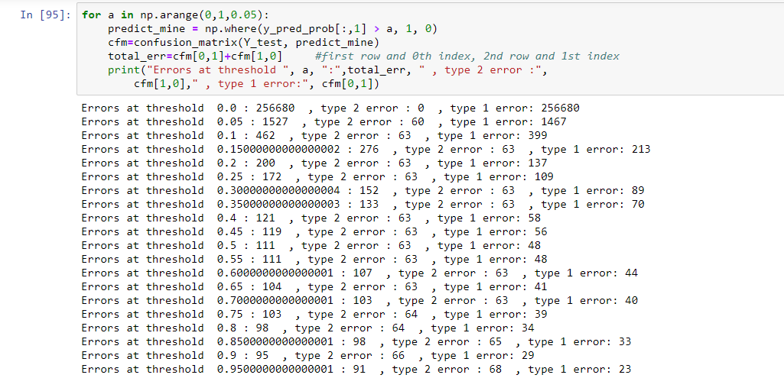
Adjusting the Threshold

Slide 38
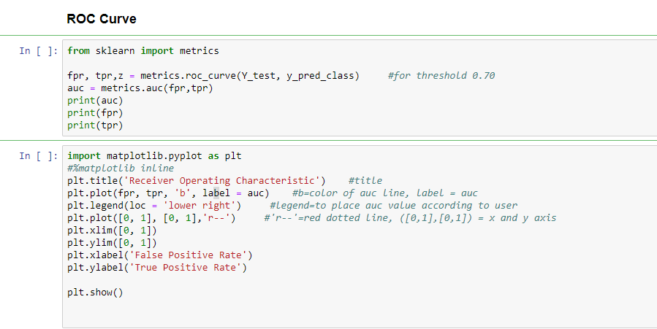
ROC Curve

Slide 39
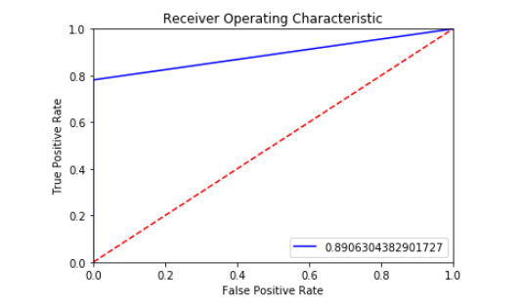

Slide 40
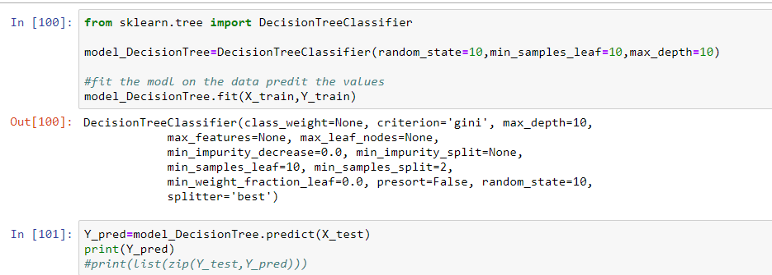
Decision Tree

Slide 41
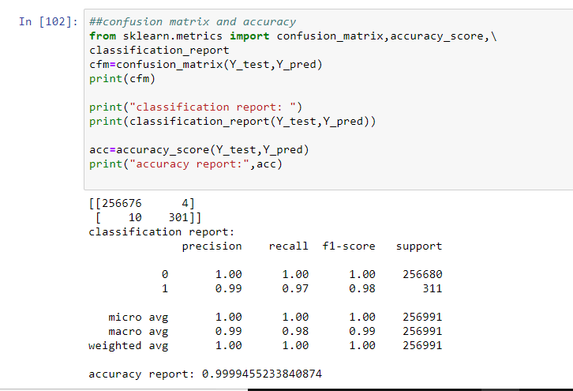

Slide 42
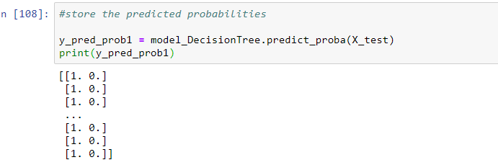

Slide 43
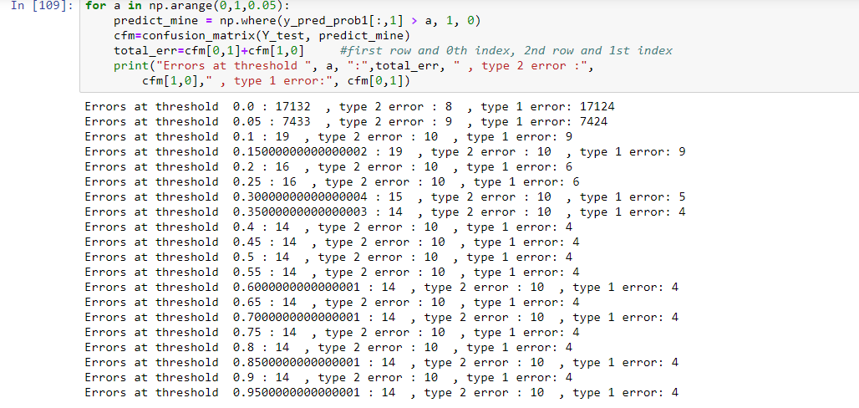
Generic code

Slide 44
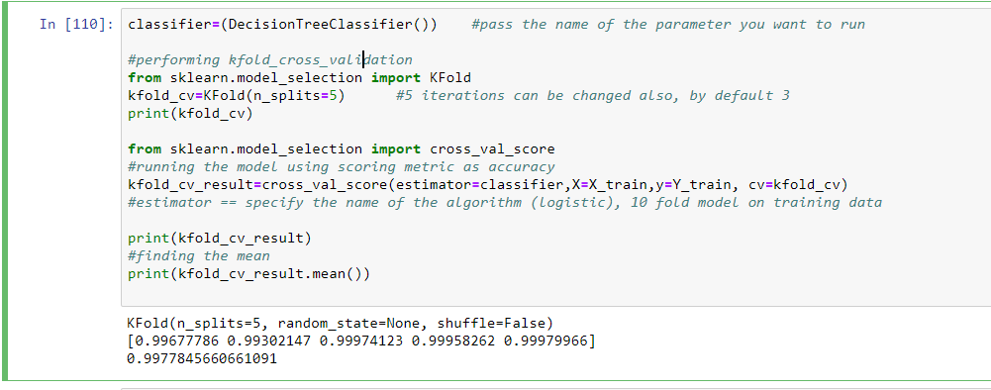
Cross Validation Decision Tree

Slide 45
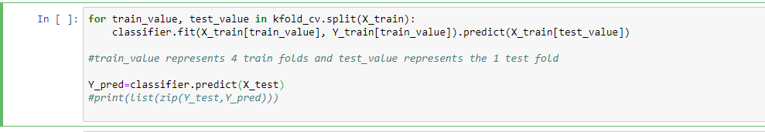

Slide 46
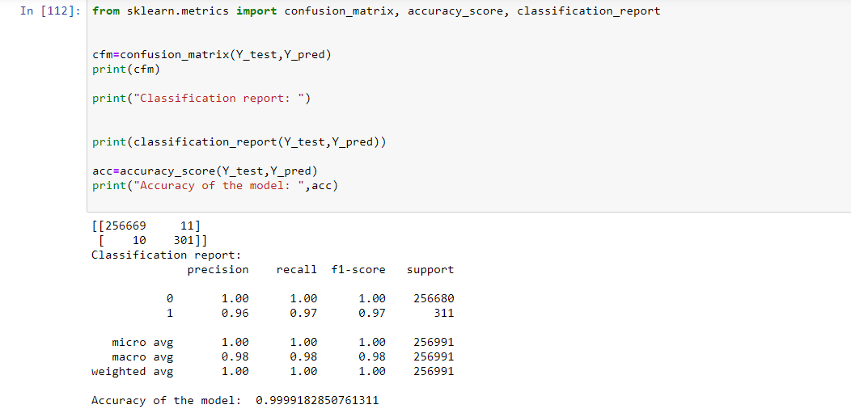

Slide 47
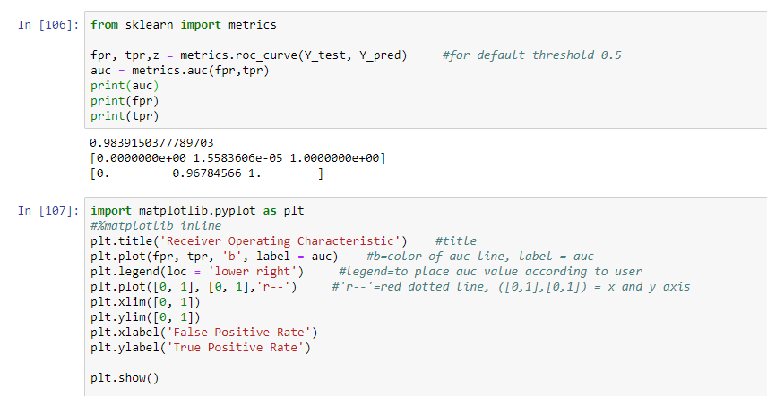
ROC Curve Decision Tree

Slide 48
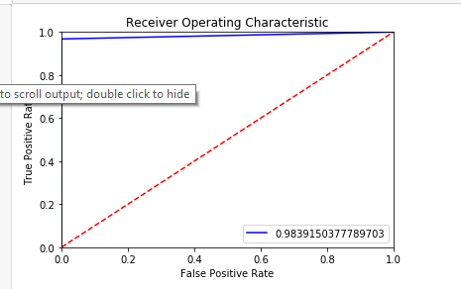

Slide 49
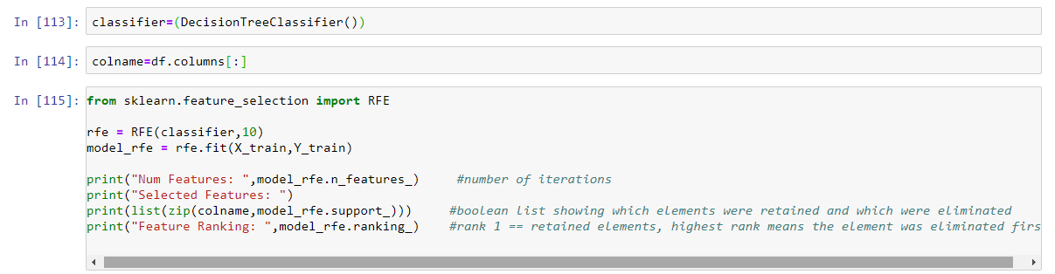
RFE

Slide 50
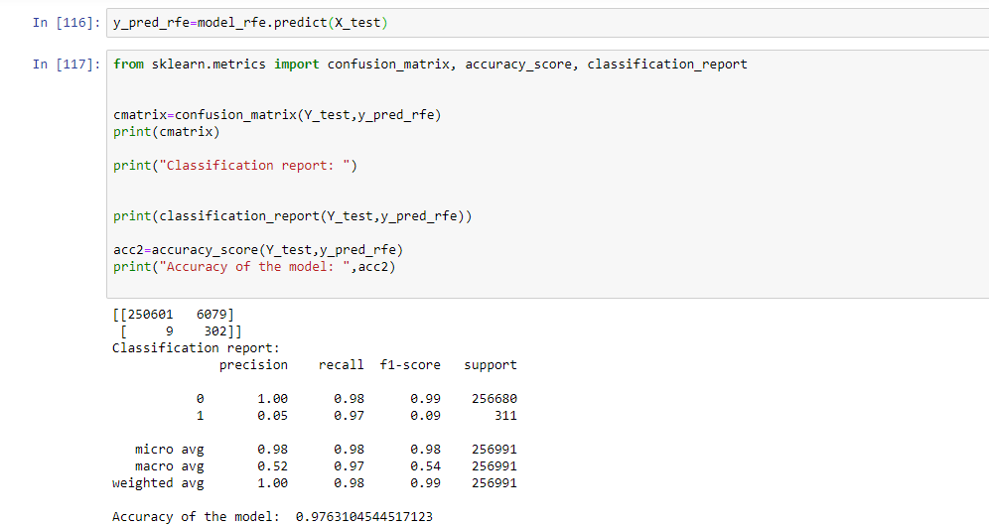

Slide 51
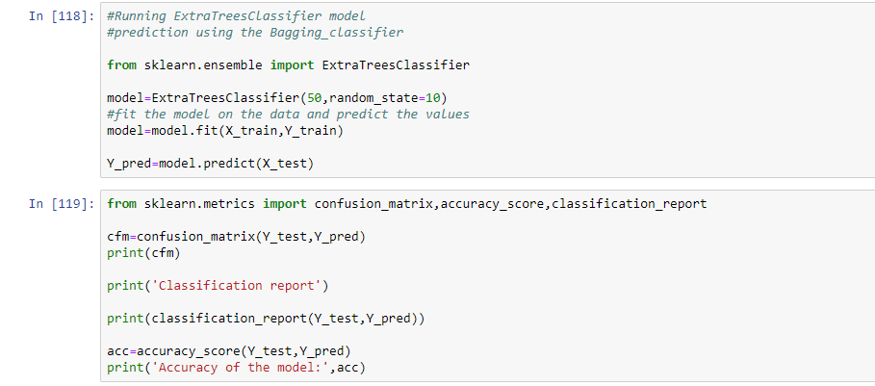
ExtraTreesClassifier

Slide 52
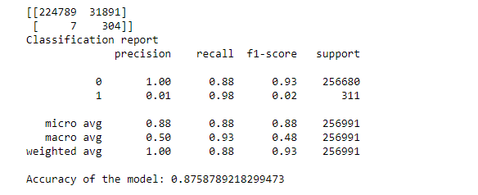

Slide 53
AdaBoost_Classifier
It assigns the higher weight to wrong classified observations so that in the next iteration these observations will get the high probability for classification.
Also, It assigns the weight to the trained classifier in each iteration according to the accuracy of the classifier. The more accurate classifier will get high weight.

Slide 54

AdaBoost_Classifier

Slide 55


Slide 56
Gradient_Boosting_Classifier
How Gradient Boosting Works
Gradient boosting involves three elements:
A loss function to be optimized.
A weak learner to make predictions.
An additive model to add weak learners to minimize the loss function.

Slide 57

Gradient_Boosting_Classifier

Slide 58


Slide 59

RandomForest

Slide 60


Slide 61

Running Multiple Models

Slide 62


Slide 63
Best Model – Decision Tree

Slide 64

Insights
Hence if the Bank implements our model it will face a loss of 1,25,175USD.
And if our model is deployed to other
Banks in future the company will have
to face a loss of approximately 0.003%.

Slide 65
Drawbacks of ML
Zomato fires 540 employees; says automation made several roles 'redundant‘. Online Chatbots.
There is no work left for young lawyers in the US now, because IBM Watson software gives better Legal Advice in a moment. In the next 10 years, 90% of US lawyers will become unemployed ... those who will save 10% ... they will be Super Specialists.
Social media company Facebook has reportedly shut down one of its AI systems because "things got out of hand." The AI bots created their own language, from the scratch and without human input, forcing Facebook to shut down the AI system in 2017.

